Slide 1
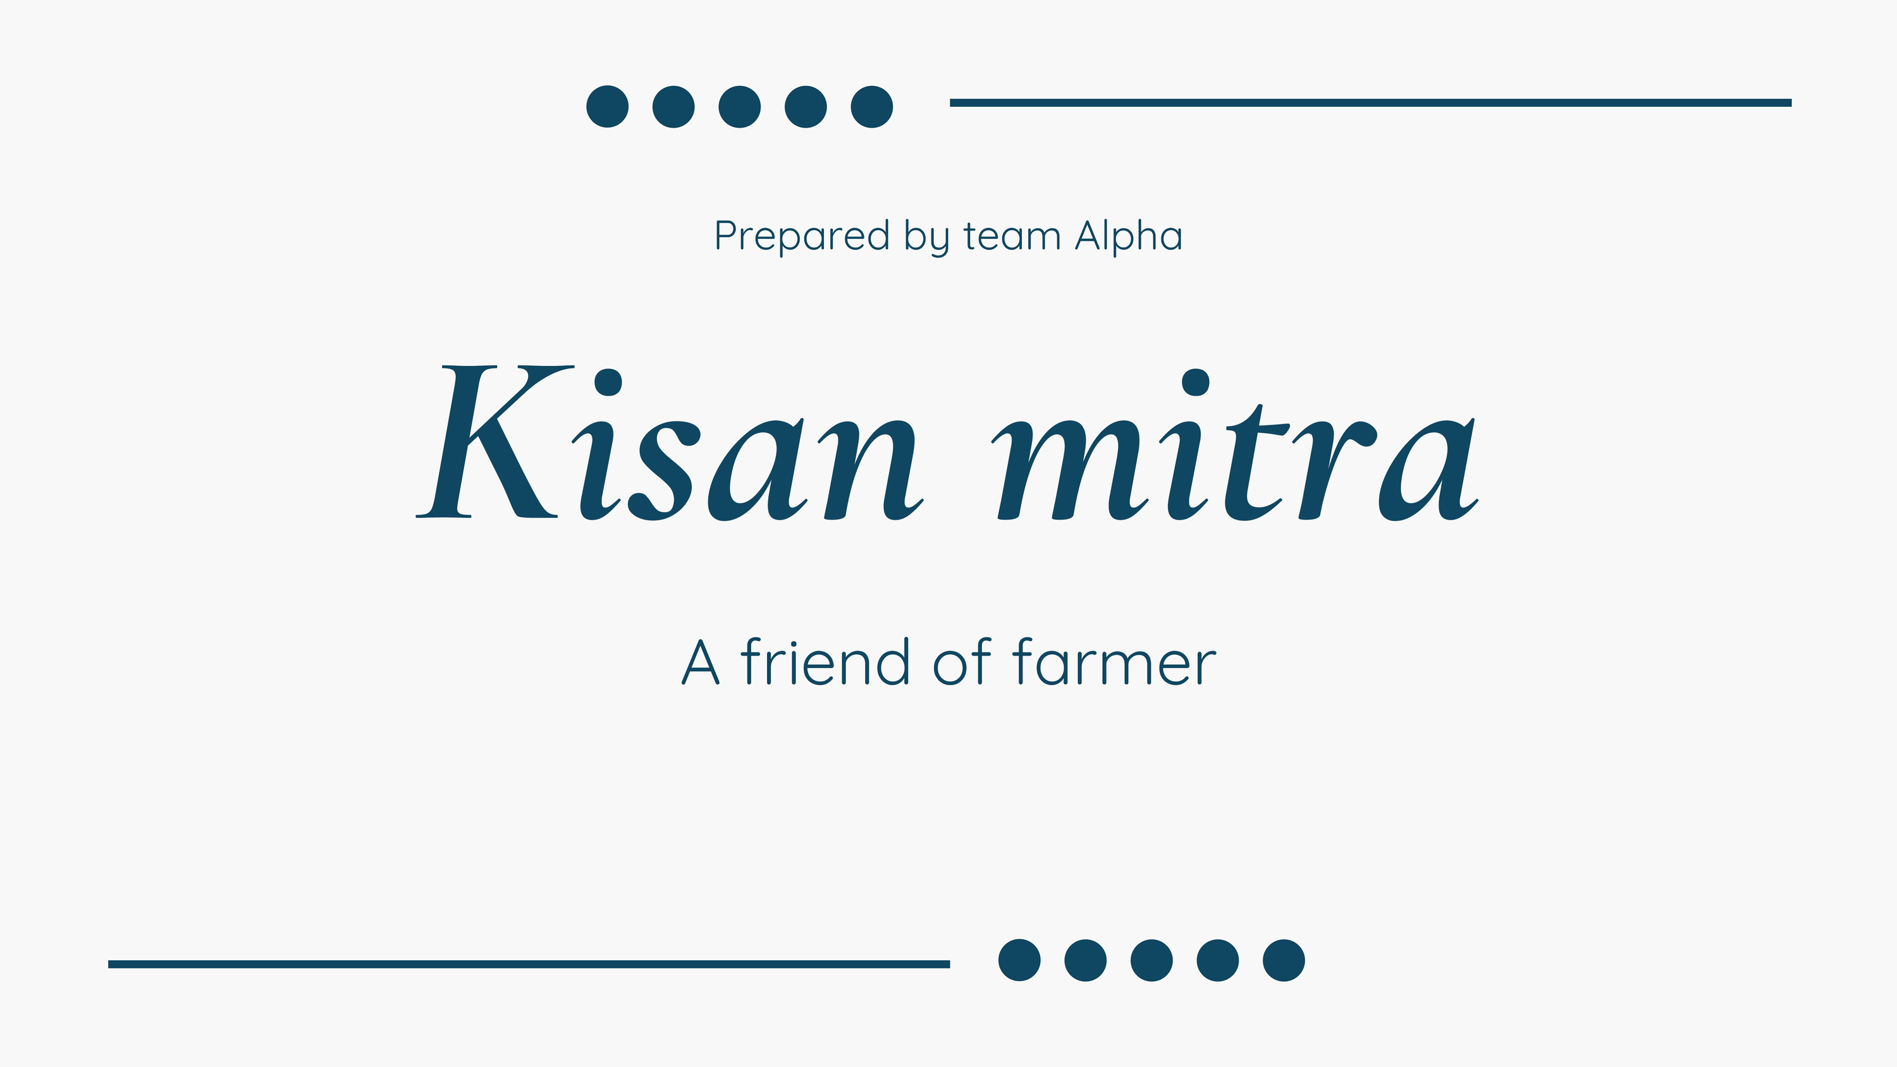

Slide 2
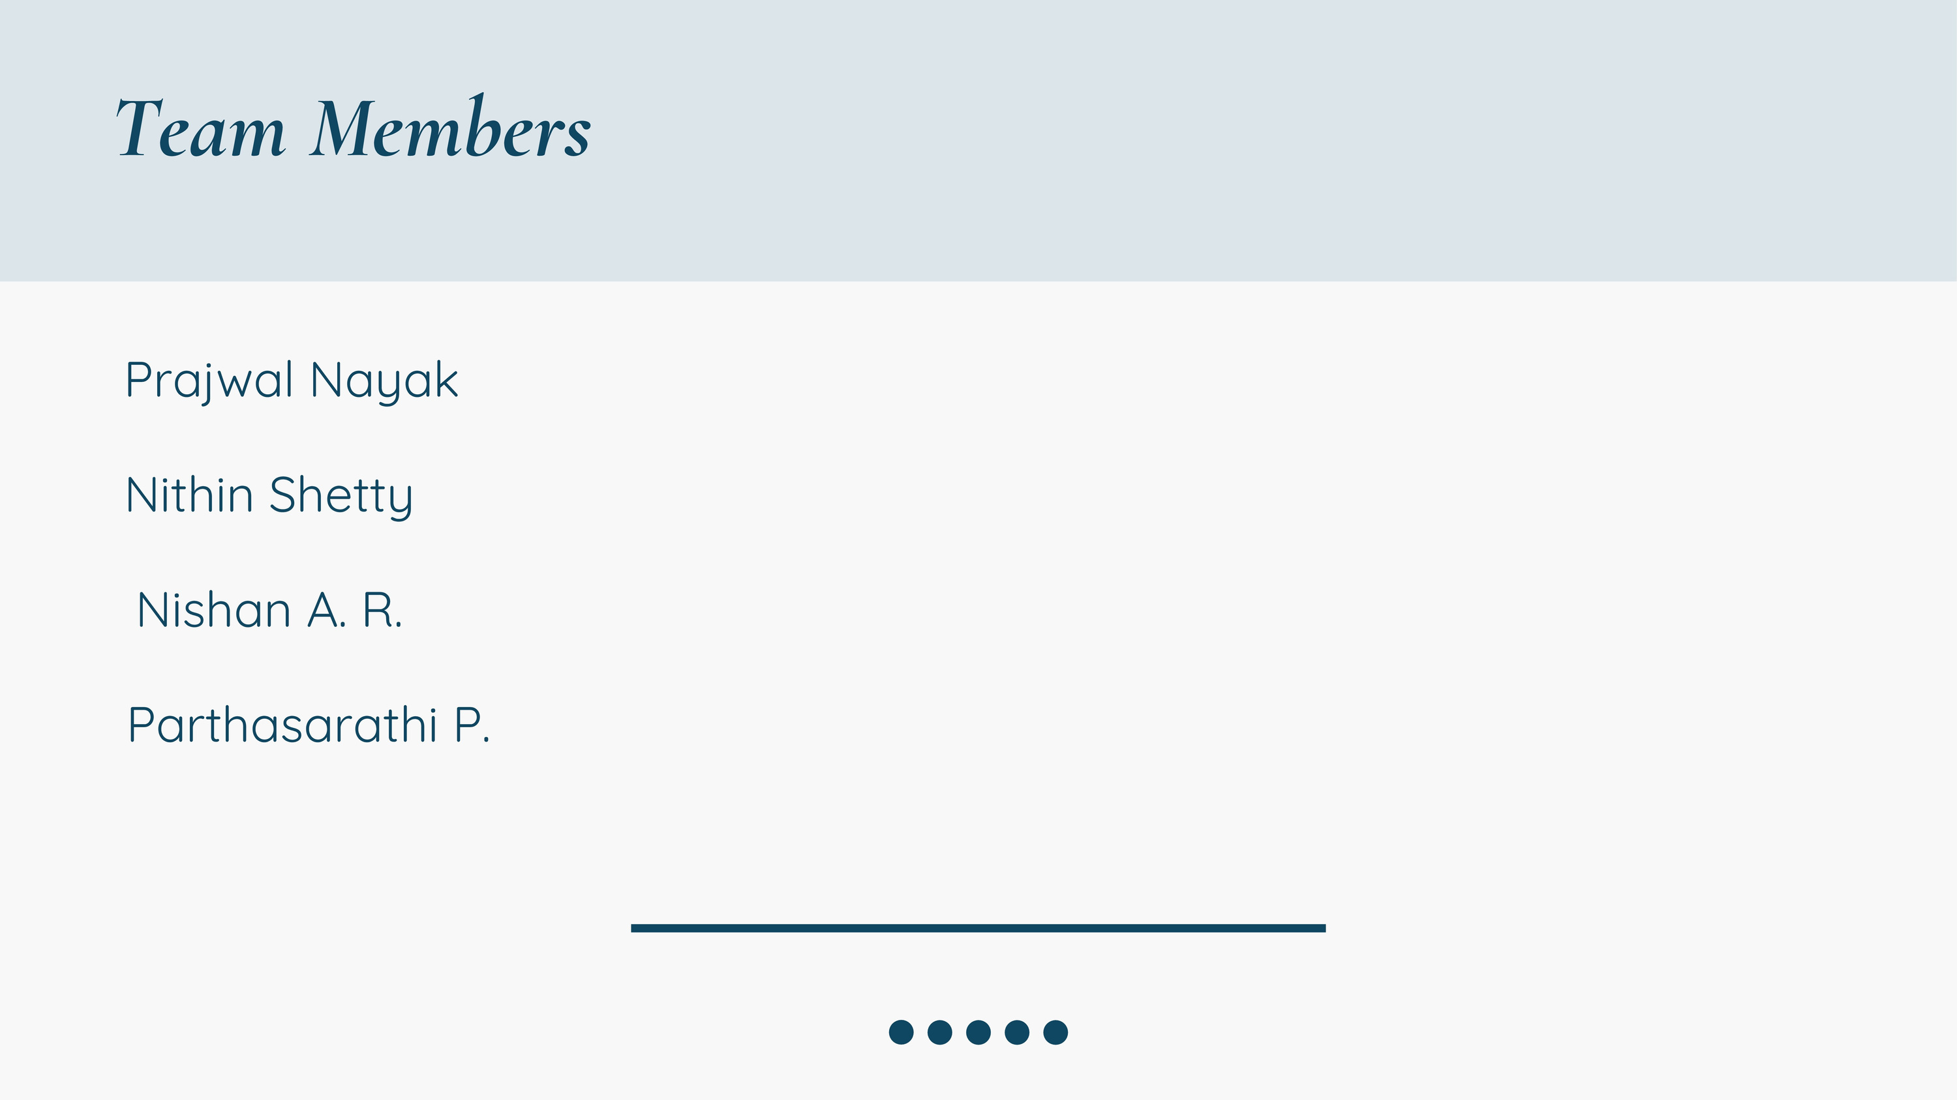

Slide 3
Problem statement
Farmers lose profits to middlemen, unpredictable weather, and poor crop choices. Middlemen reduce their earnings by controlling market prices, while extreme weather and lack of timely information lead to significant crop losses
An AI-driven solution with real-time weather updates, price predictions, and crop recommendations can boost incomes, improve yields, and promote sustainable agriculture.
Quicksand
Quicksand
Quicksand

Slide 4
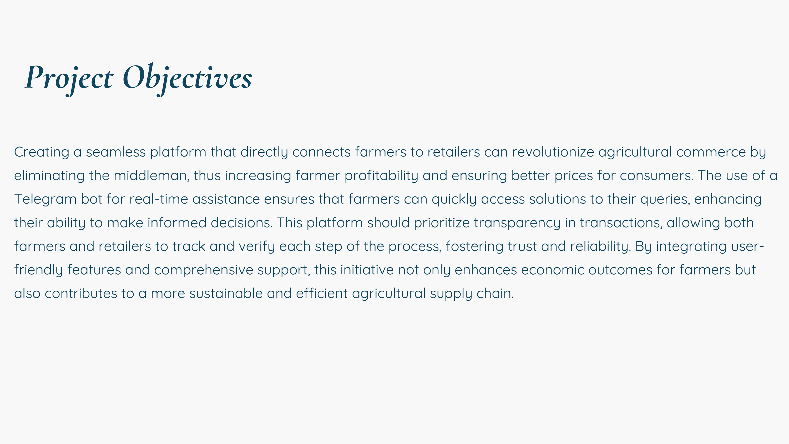

Slide 5
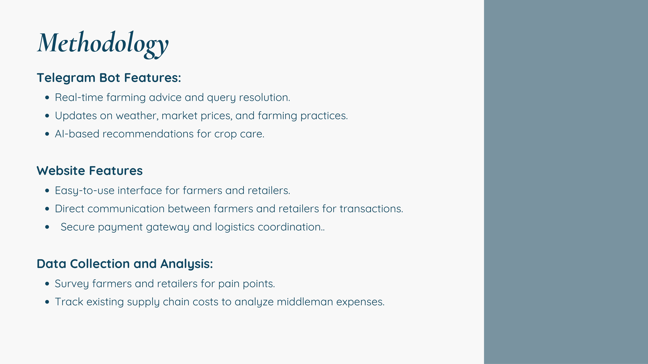

Slide 6
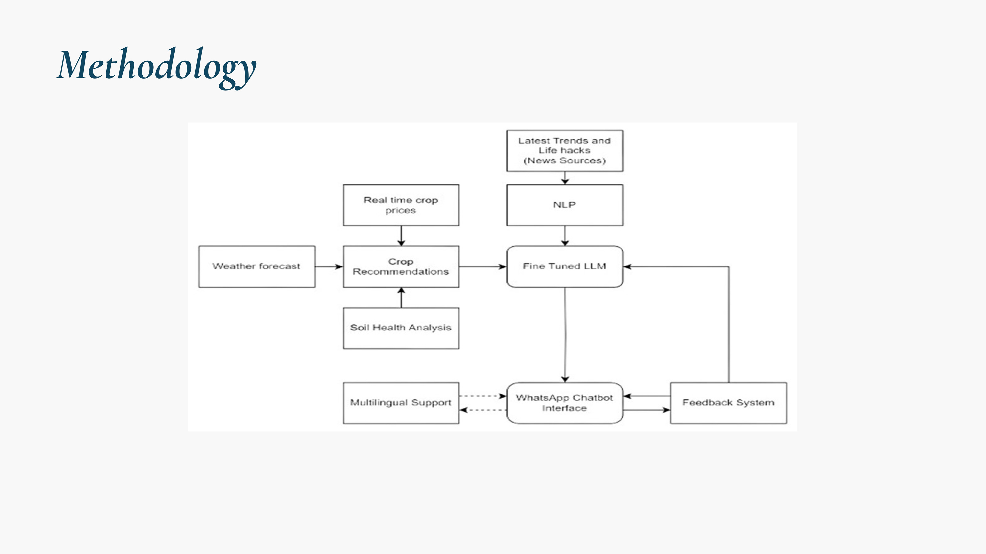

Slide 7
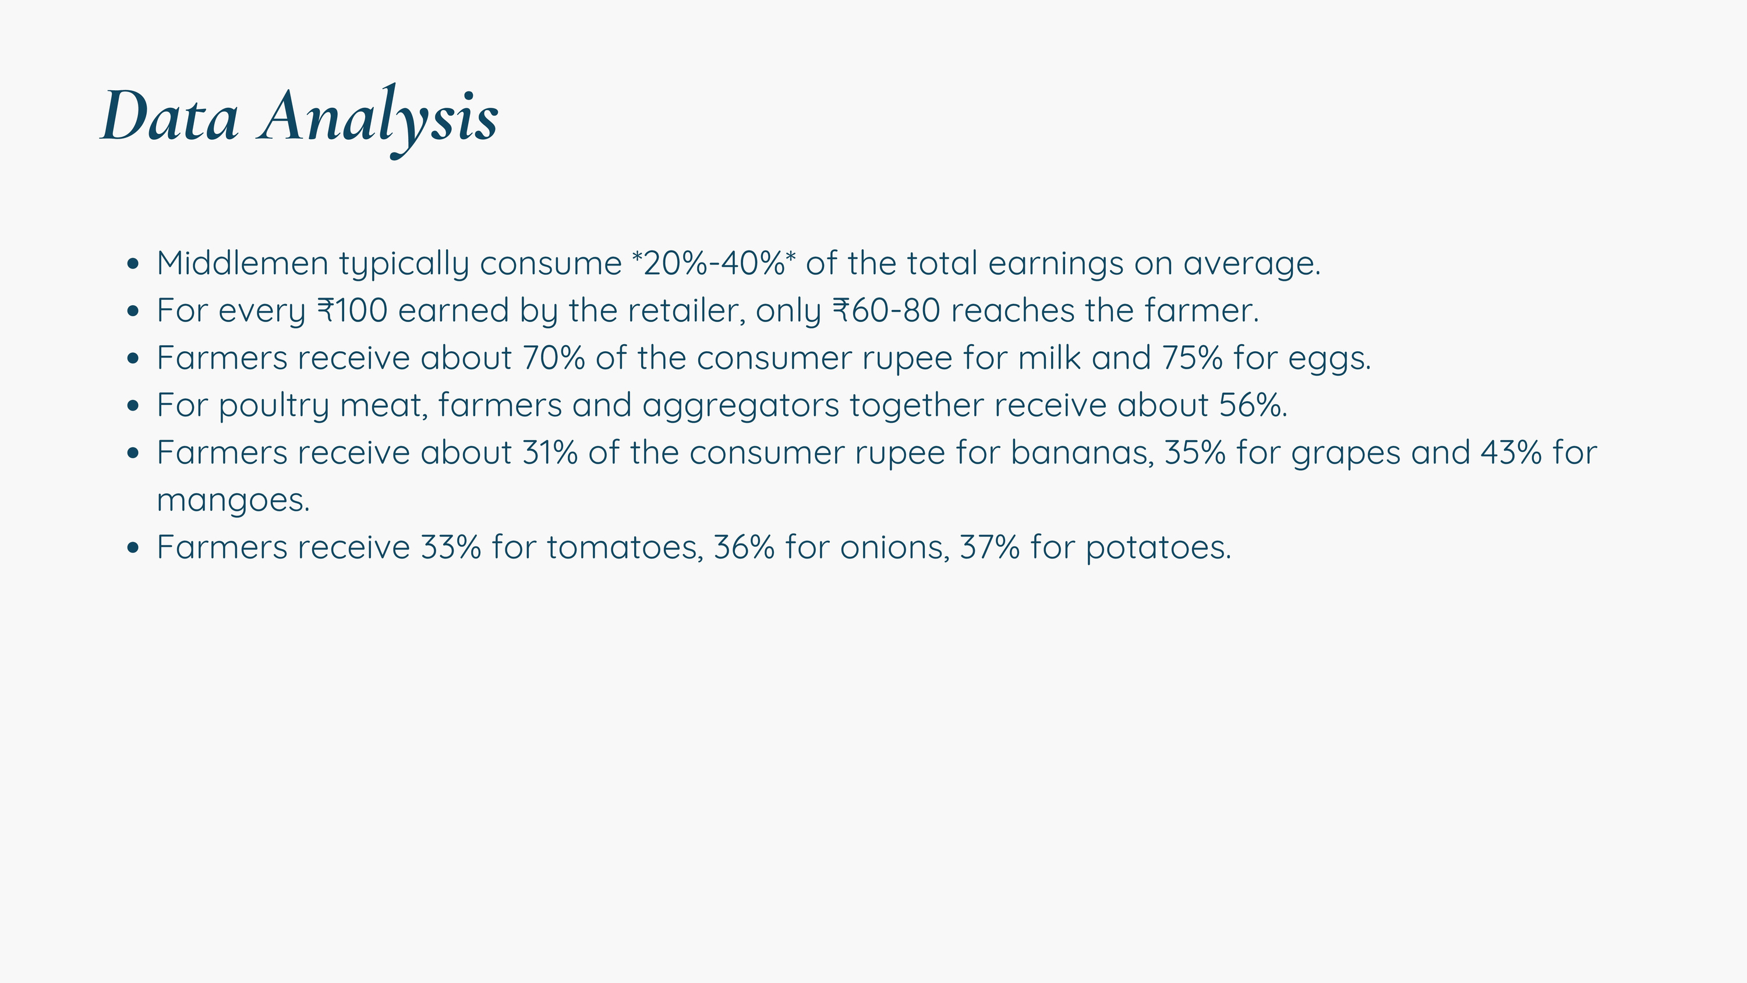

Slide 8
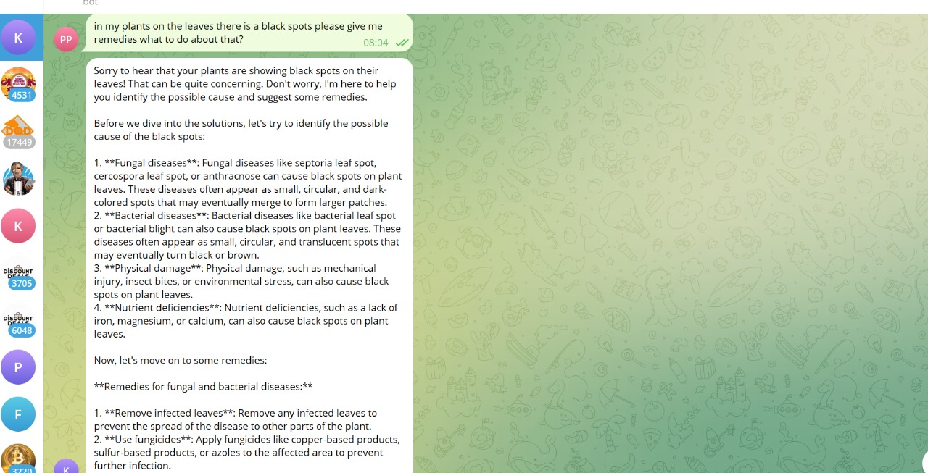

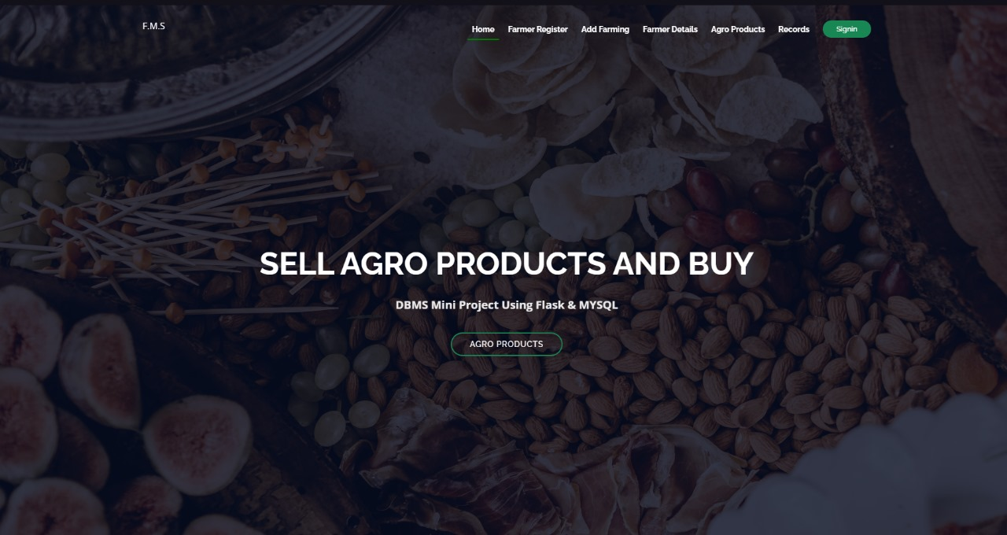
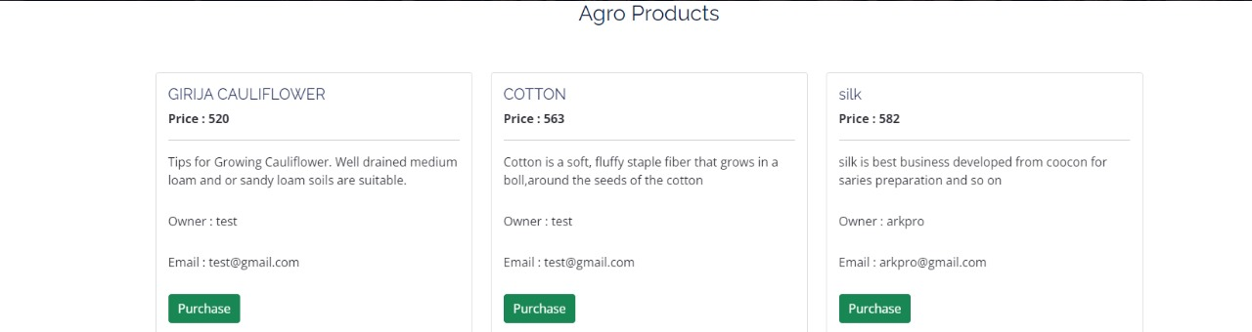
Results

Slide 9
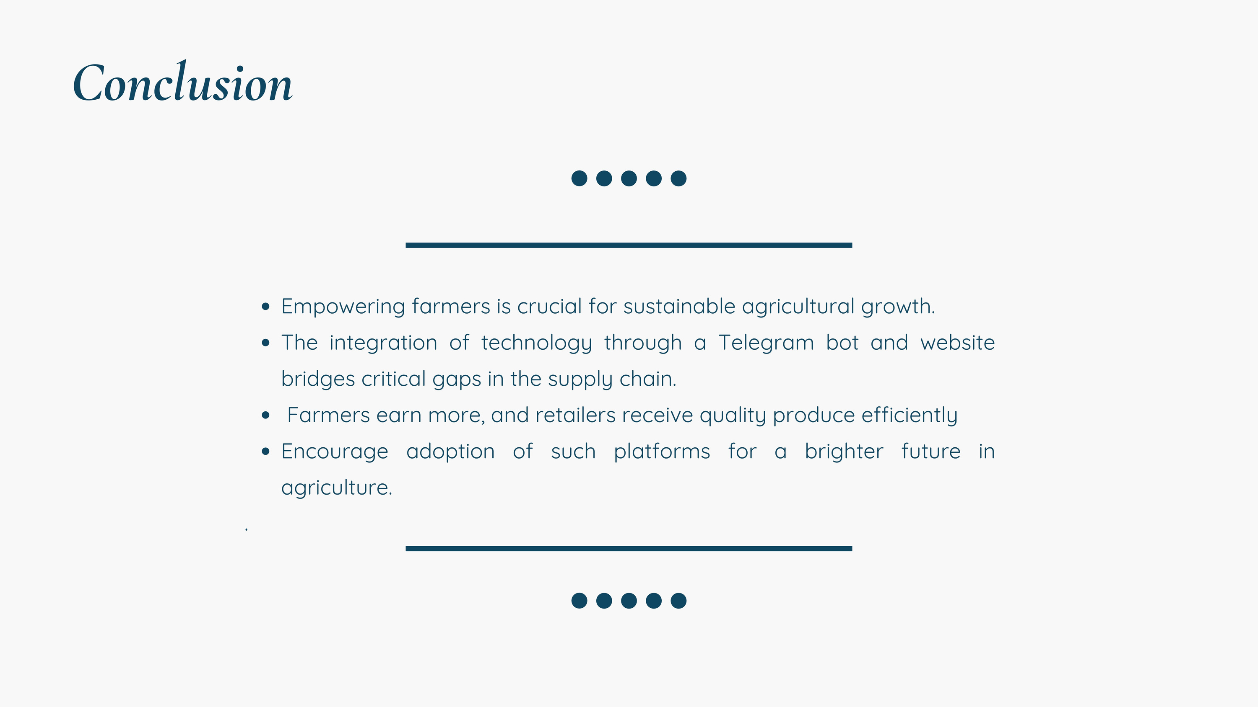

Slide 10


